Slide 1
Delegates
IN710 OOSD 2017
Session 7.2
Notes:
We have been looking at design patterns – little architectural templates that developers have found useful in OO programming.
You should be alert for situations where a Strategy, Factory or Observer pattern is something you need to use.
There are other patterns (20 or so). You should look them up and learn about them.
Go to dofactory.com and you can see them all, organised by how often they come up.
We are now going to turn our attention to the next step after architecture: knowing your IDE.
Since we are doing .NET development, we will spend the next couple of weeks looking at some advanced features in the .NET system.
Although we are specifically concentrating on this system, you should realise that all IDE’s should provide some facility for the general programming tasks we are learning (function passing, multi-threading, event handling, etc.), and be prepared to learn the particular approach for whatever system you are being paid to build in.
We start today with delegates. This is the technique that C#.NET uses to allow functions for be treated like objects and passed into and out of methods.

Slide 2
Delegates
Delegates are a special kind of C# type.
A delegate instance holds (i.e. its value is) some code.
Delegate instances can be passed as arguments just like any variable.
Using a delegate instance causes it associated code to be executed.
Notes:
The way int instances hold an integer value or String instances hold a set of characters.
We will see the syntax for creating and using delegate instances.
Delegates are extremely powerful and, as we will see next week, integral to how events are implemented in C#. You will need to get very comfortable with delegates so you can write your own custom events.

Slide 3
Working with Delegates
Define a delegate type that specifies a method signature.
Instantiate an object of that type, associated with a particular subroutine that matches the required method signature
Use the delegate wherever you want to execute that subroutine’s code.
Notes:
method signature = return type and argument list
We make the association by passing the code in to the delegate constructor (example to follow).
You can think of the delegate object as a little wrapper that makes a method into a piece of data that can be used whenever it is needed.
We will see why we would want to do this shortly; if you’ve done a lot of JavaScript, you’ve already seen several cases where it is useful

Slide 4
Syntax. Warning: It’s Confusing
public delegate returnType delegateTypeName(argList)
public delegate void UsesAnInteger(int x);
Notes:
They’ve made a syntactic choice here that leads to a lot of confusion. As we shall see, the syntax for declaring a delegate type looks a lot like the syntax for defining a function, even though they are totally different things. You might think that some day this will become so familiar that it won’t be confusing anymore.
This is not the case. It will always be confusing.
Syntax
The scope modifier
The delegate keyword
The return type of the method signature this delegate type specifies (and so can be instantiated with)
The delegate type name. NOT A FUNCTION NAME. THIS IS THE DELEGATE TYPE NAME.
The argument list of the method signature this delegate type specifies (and so can be instantiated with)
This specifies a method signature with return type returnType and arguments argList
The name of the delegate type is delegateTypeName (and it behaves like any other type)
We can make an instance of this type using any function that matches the specified signature.
Example:
This particular delegate describes a function that takes one integer and returns void.
The delegate-type name is UsesAnInteger
We can instantiate the UsesAnInteger type with any function that takes one integer and returns void.
We will see how to instantiate in a minute

Slide 5
Syntax
public delegate void UsesAnInteger(int x);
You have defined a delegate type called “UsesAnInteger”.
All delegates are descended from System.Delegate and use its base class constructor.
The constructor accepts the name of a method
To create an instance of this delegate type, you will provide a method that accepts an int and returns void.
You pass the appropriate method into the UsesAnInteger constructor.
Notes:
All delegates have the same constructor format. It takes a single argument, which is the name of the function you want to make into a delegate instance.
Note that with classes, we have two words – class and object. Class is the generic definition of the thing and object is an instance of the class
For delegates there is only one word. You have defined a delegate (generic) and you will create a delegate (instance). This is confusing.
The syntax of instantiation is also confusing, as we will see.
These are language-design issues, and this is a mistake that may be corrected some day.
All delegates use this inherited constructor, which accepts one input parameter – the function you are associating with the delegate instance

Slide 6
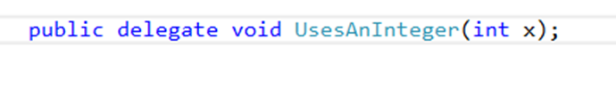


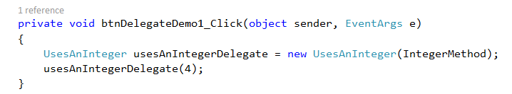
Example
Notes:
Assume you have all this code in Form.cs
We will declare the delegate type in the namespace but outside of the class, so everyone in the namespace can see it (just like an enum)
First the delegate declaration
Then we write a method in the form that matches the signature. Note that the delegate declaration specified a function that returns void and accept a single int. Our method has precisely that structure.
Then in a button click handler, we first instantiate the delegate type. See that it is a type and we declare a reference variable of that type to hold the result of the constructor call (the “new”).
See also that we pass the method in by name. Don’t put parentheses there, it will not work.
…and then we call the delegate instance.
To call a delegate, you say its name, like a normal function call. You pass arguments into it like a normal function call.
This causes the execution of the code passed to the delegate constructor.
In this case, you get a MessageBox with “5” in it.
Let’s look at another example, then we will think about why we would want to go to all this trouble…

Slide 7
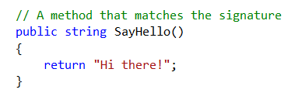
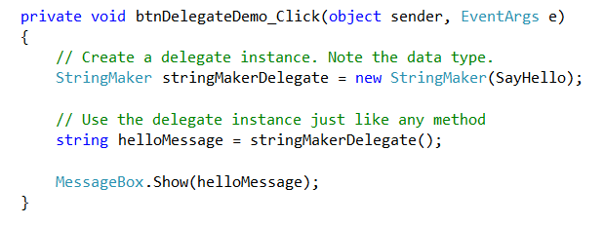
Example
Notes:
Here is a delegate type that specifies a method signature: returns a string, accepts no arguments.
Declare the delegate type
Make a function that matches the delegate signature
Create an instance of the delegate
All delegates have a constructor that accepts a single argument. The argument is the name of the function you wish to associate with the delegate instance. It doesn’t matter what the delegate type returns or accept. Just the name of the function goes into the constructor call.
Note that if you try to pass a function into that constructor call which doesn’t match the delegate type, it won’t compile.
Call the delegate like a function, with empty () because this delegate type accepts no parameters.
It returns a string, which we pop up.
The call to stringDelegate here is exactly the same as calling sayHello (the message box will display Hi There)
Great, but totally pointless. Why not just call sayHello?
So why would you actually ever want to do this?

Slide 8

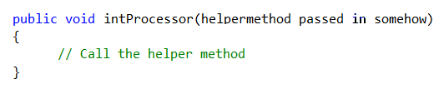
Why Use Delegates?
Notes:
Let’s think about it….
Imagine that you have a method that operates on data.
Every time you call the method, you want it to operate on a different piece of data and/or you don’t know what date values it will get until runtime.
What do you do? => You pass the data in as an argument.
We have been doing this for years
Every time you call the method, you can give it different data, and thereby get different results.
Now imagine that you have a method that calls another method (we will call him the “helper” method) as part of its processing.
Every time you call that original method, you want it to call a different helper.
And/or you won’t know until runtime what the helper method should be.
You can do this in C# by passing in a delegate. Calling the delegate inside the method is exactly equivalent to calling the associated function’s code.

Slide 9
Delegates
Allow functions to be passed around as arguments to other functions.
Allow helper functions to be bound at runtime
Are an essential part of the way C# handles events and threads.
Notes:
“Binding at runtime” means that, for example, you could have an if statement that, based on which radio button was selected, created and passed in a different delegate (i.e. a different chunk of code).

Slide 10
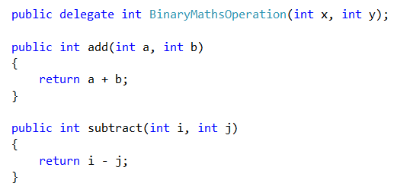
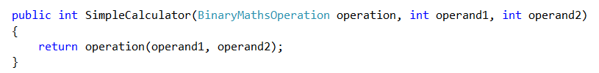
Example
Notes:
Let’s start with a delegate definition and two methods that match the delegate’s method signature.
Note that the variable names given to the parameters are irrelevant, as always. It is the data types that must match.
We can write a method that expects, as one of its arguments, an instance of the delegate type.
How do we use it?

Slide 11
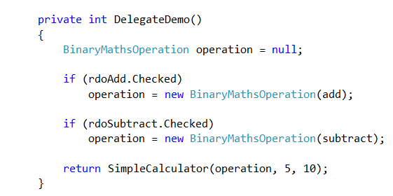
Example
Notes:
Here’s an example.
SimpleCalculator wants a BinaryMathsOperation instance.
This will be a delegate instance, which encapsulates a method that takes two ints, and returns an int.
Both add and subtract on the previous slide match this method signature
With the delegate technique, we can decide at runtime what code SimpleCalculator will execute.
Here, based on the user’s choice of a radio button, we make a delegate using one of the two candidate methods
We pass that object to simpleCalculator.
What does this method return if rdoAdd is checked? => 15
What does this method return if rdoSubtract is checked? => -5
So we get different behaviour from SimpleCalculator (adding vs subtracting), without touching its code.
We could easily expand this to allow any computation that takes two ints and returns an int.

Slide 12
Example
Notes:
Here’s an example.
SimpleCalculator wants a BinaryMathsOperation instance.
This will be a delegate instance, which encapsulates a method that takes two ints, and returns an int.
Both add and subtract on the previous slide match this method signature
With the delegate technique, we can decide at runtime what code SimpleCalculator will execute.
Here, based on the user’s choice of a radio button, we make a delegate using one of the two candidate methods
We pass that object to simpleCalculator.
What does this method return if rdoAdd is checked? => 15
What does this method return if rdoSubtract is checked? => -5
So we get different behaviour from SimpleCalculator (adding vs subtracting), without touching its code.
We could easily expand this to allow any computation that takes two ints and returns an int.

Slide 13

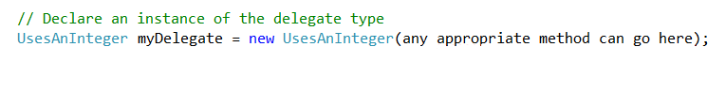
More on Instantiation
Notes:
Let’s look a little more closely at how to create an instance of a delegate type.
The rule is this: Given a delegate type definition, I can create an instance of that type using any appropriate method.
An appropriate method is one with the same method signature (return type and args) as the delegate type.
Schematically, it’s like this…
But where do these “appropriate methods” come from?
In the examples we have looked at so far, we have just written them in the Form and declared the delegate instances in the Form, so the methods were just sitting there in scope.
But more frequently, our methods belong to a particular class, usually one we have defined ourselves.
Can we make a delegate out of one of those methods?
Sure. All we need to do is create an object who exposes the method we want, and refer to it through him.

Slide 14
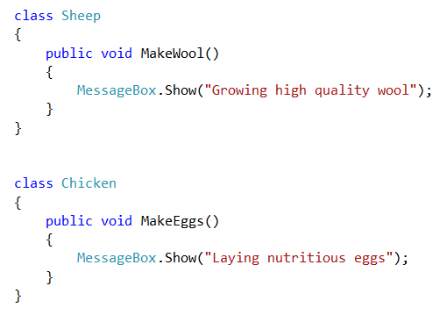
Using an Instance Method
Notes:
Let’s build some farm management software.
We’re going to use very simplified behaviour in our instance methods, to keep the example clear, but the logic is of course the same regardless of how much code the methods contain.
Let’s start with a couple of classes..
These classes each contain a method with the signature return type = void; arg list = empty.
Remember those methods.

Slide 15

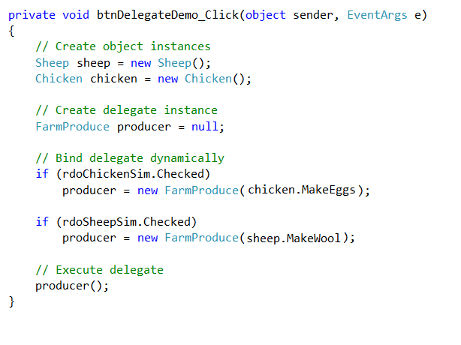
Using an Instance Method
Notes:
Elsewhere, say in the Form, or in a FarmManager class, I can define a delegate type.
This matches sheep.MakeWool() and chicken.LayEggs()
So if I could get hold of those methods, I could use either one of them to create an instance of FarmProduce, that I could call wherever I wanted.
How can I get MakeWool? => I need a sheep.
How can I get LayEggs? => I need a chicken.
So, I can do something like this (dynamic binding).
How does this work? => if rdoSheep is checked, I see “Making wool”, if rdoChicken is checked, I see “laying eggs”
(There is a special type of class – a static class – that allows you to call its methods on the class name, without creating an instance.
With a static class, you can therefore also create a delegate without creating an instance, by calling a static method on the class name.
Static classes are created as public static class className and may not have and non const data fields.)

Slide 16


Summary
Declaration
Instantiation
Invocation
Notes:
So there are three steps to working with delegates:
Declare the delegate type
Instantiate an instance of the type
Invoke the method
The delegate type usesAnInteger takes an int
Appropriate method is declared somwhere in scope, and must return void and must take an integer argument.
This could also be done as objectInstance.appropriateMethod or staticClassName.appropriateMethod
myDelegate is a stand-in for appropriateMethod. Therefore it also takes an int
In the example, this is functionally exactly equivalent to saying appropriateMethod(15)

Slide 17
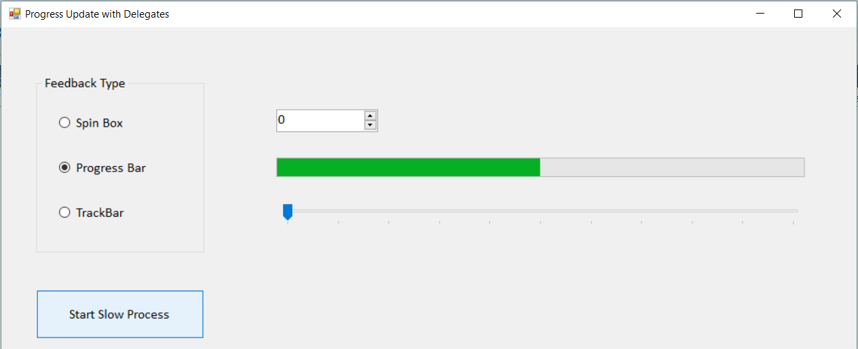
Example Application
Feedback Display
Notes:
The progress display is an important UI thing.
For discussion, assume that you have some piece of code that takes a long time to do something. A file upload or a large data processing task, or whatever.
At intervals, it updates some feedback control to keep the user informed.
You would like this method’s feedback control to be configurable. That is, you want to be able to decide at runtime, what the display will be. We want to either increase the value of a spinbox, call the step function of a progressBar control or increment the value of a trackbar control.
How might you do this with delegates?
=> Assuming that you can write three methods, each of which does one of these things, and that you can arrange for them all to have the same method signature, you could give the Form a delegate instance and bind it to the appropriate method at runtime. When you called it, the correct behaviour would appear.
For simplicity, in this demo, we are just going to have all three controls on the screen all the time.
IRL, you would manipulate their visible properties as required.

Slide 18
Feedback Display
public void slowMethod(feedbackDelegate)
{
while not finished
{
Work for some time….
Call the feedbackDelegate, to update a feedback control
}
}
Notes:
Here is the general structure
slowMethod takes a long time for computation or data processing or something
When we call it, we will pass in the method is should use to manage its progress feedback
It runs as a loop, where it works for a while, then calls the delegate, works for a while, then calls the delegate, and so on.
Without ever having to modify slow method, you can have any kind of feedback work that you want, simply by passing in the appropriate delegate method.
So we need a delegate type, and matching methods to instantiate it with.

Slide 19
Feedback Display
slowMethod(spinBoxUpdater delegate);
slowMethod(trackBarUpdater delegate);
slowMethod(progressBarUpdater delegate)
Notes:
Assuming we can get the delegate signature right, we could have these different method calls.
Assume that spinBoxUpdater is a delegate made from a method that updates the spinBox, and equivalently for the other two.
Different calls, different controls would respond.
What should the delegate be? That is, what method signature does it specify?
To decide this, you need to figure out what those methods will have to be.
You must decide:
What is the return type?
What is the argument list?
In this case, we just want the methods to udpate a control.
To make it simple, let’s let all three methods belong to the form (because it has direct access to the controls).
Then what should they return? => void.
And what data do they need? => void.
Here is what they would look like…

Slide 20
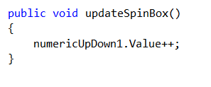
Feedback Display
Notes:
I have dropped a spinBox (numericUpDown in VS) on the form and not changed its default name.
This increases its displayed value by 1

Slide 21

Feedback Display
Notes:
Here’s the progressbar
This is how you update a progressBar. It has a min, a max and a step size. Just does the math.
We will leave the track bar method as an exercise.
So, how do you declare the delegate type?

Slide 22



Feedback Display
Notes:
So this is how we declare the delegate type
And how do we instantiate an instance of that type? (On two lines to fit on slide…)
You would have some logic that looked at which radio button was checked, and passed in one of the three update methods based on that user choice.
And how do we call slowMethod and pass in that delegate instance?
Note carefully that you do not put the “()” in there. That is a function call. Here we are passing the function itself, by name. Be careful with this; including those brackets is the most common error.
And finally, what does slowMethod do?
Remember the generic structure….

Slide 23
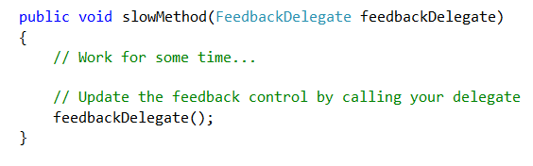
Feedback Display
Notes:
Here we are calling a function – a delegate, but a function nonetheless – so we have the brackets.
And the corresponding control will change.
You will be building this one in practical

Slide 24
Multicast Delegates
So far, we have associated each delegate instance with a single method
It is possible to assign multiple methods to a delegate.
Calling the delegate executes all the associated methods.
Notes:
We will look at these in more detail when we get to events
We mention it now so that you’ll now what is meant if you stumble across the term.

Slide 25
Question?
Which of the Design Patterns we have used would be easy to implement using delegates?
Strategy
Notes:
Also a variant of subject/observer.

Slide 26
For More Advanced Coverage
Michaelis & Lippert, Essential C# 6.0.
Chapter 12, part 1 (includes some syntactic shortcuts)
Albahari & Albahari, C# 6.0 in a Nutshell
Chapter 4

Slide 27
Practical

